Slide 1

Time Series Analysis of Cryptocurrency Data and Design of a Trading Algorithm using Ethereum Coin
Atacan Kavdır, Furkan Kasapoğlu
Date: January 4, 2021

Slide 2
Overview
Details
Data
Decomposition & ARIMA
Feature generation
XGBoost
Trading Algorithm
Evaluation
Further Research

Slide 3
Coin Market Forecasting - Benchmark
The aim of the project is to build a pipeline of models and trading algorithms to create and compare benchmarks with identification and discussion of possible biases.
Objective
Analysis& Encoding
Ensemble
Trading Algorithm
Decomposition & ARIMA
Feature Generation
Evaluation
Crypto Market Multivariate time series
Optimal configuration of Model & Trading Algorithm
Input/Output
Coin Market Forecasting Tool
Process
EDA
Onehot & Circle
Standardization
Time Series
Decomposition
ARIMA
Auto-ARIMA
Time lags
Trends
Date Components
XGBoost
Regression
Classification
C-Validation
Algorithm Development
Parameter optimization
Simulation
MSE
MAPE
Profit Comparison
Tools
Further
Additional Data
Short Orders
Different Coins
3

Slide 4
Overview
Details
Data
Decomposition & ARIMA
Feature generation
XGBoost
Trading Algorithm
Evaluation
Further Research

Slide 5
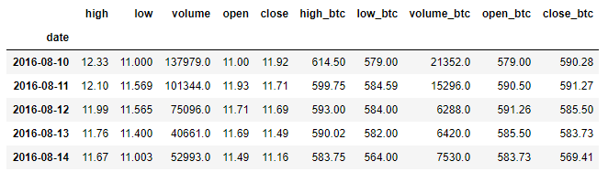
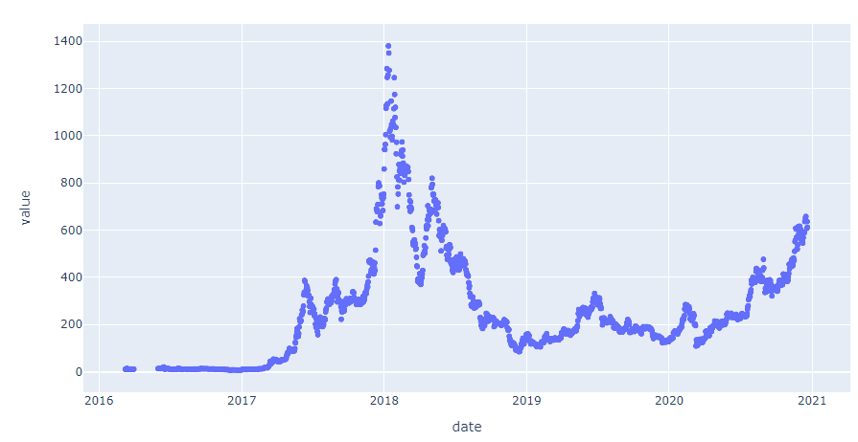
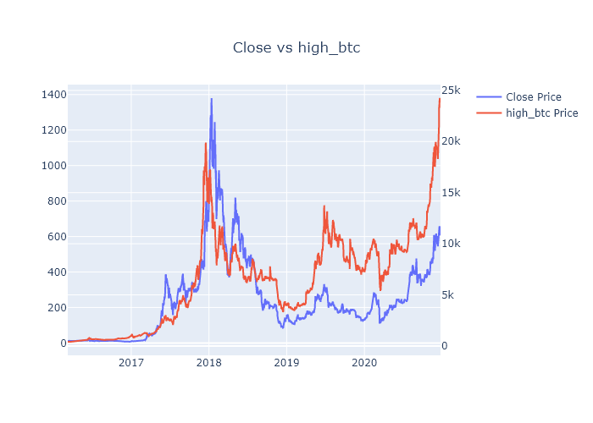
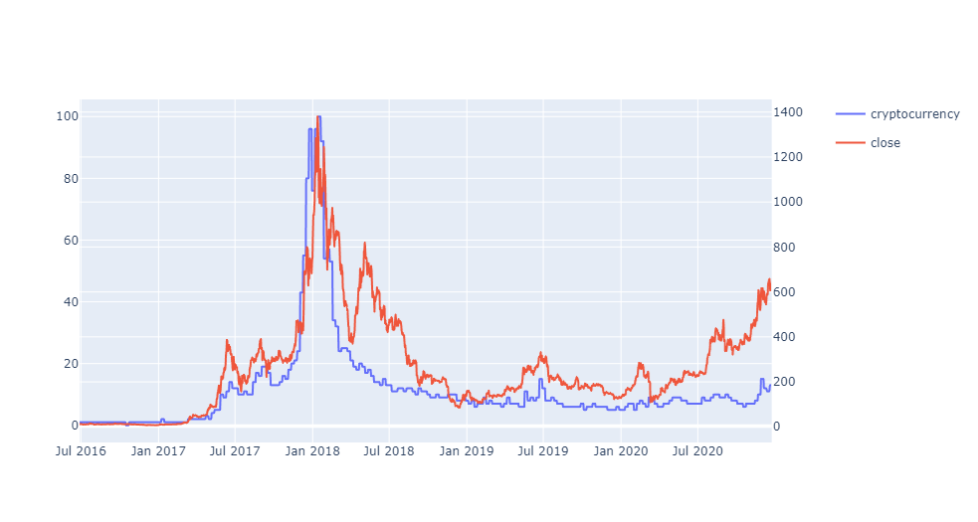
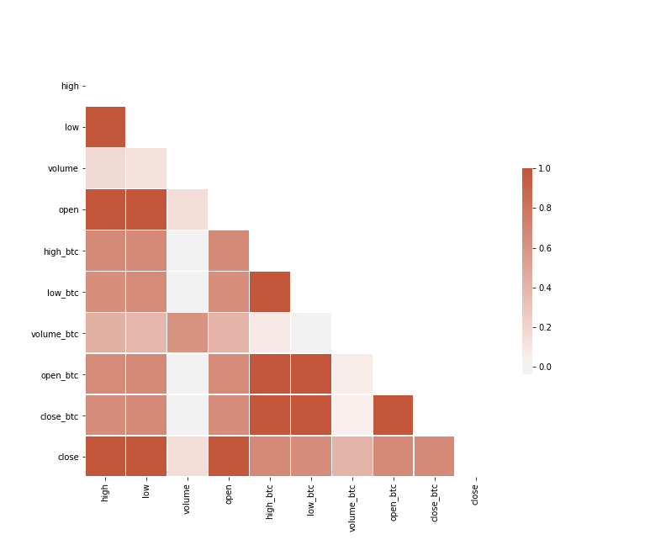
Coin Market Forecasting - Data
Columns
Checking missing values
Correlation of Lagged values
Close Ethereum vs High Btc
Close price of Ethereum and Google search trends of “cryptocurrency”

Slide 6
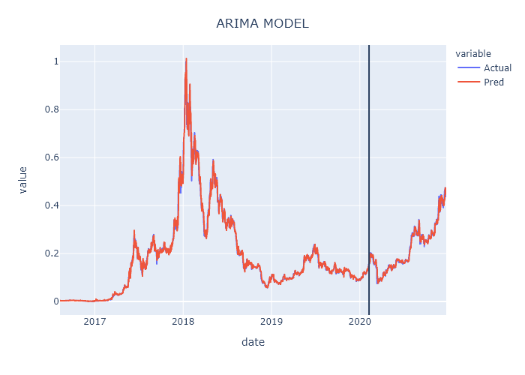
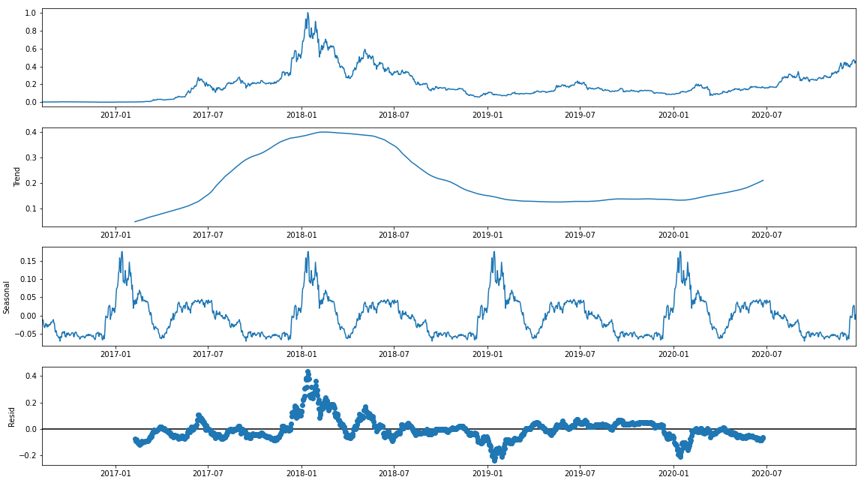
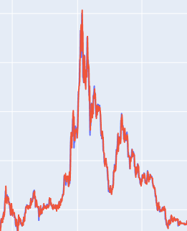
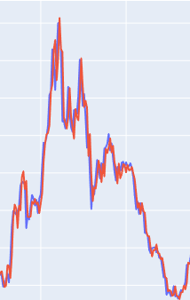
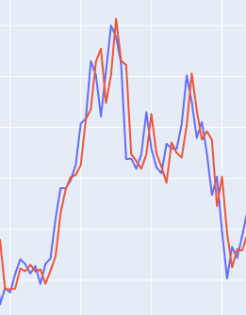
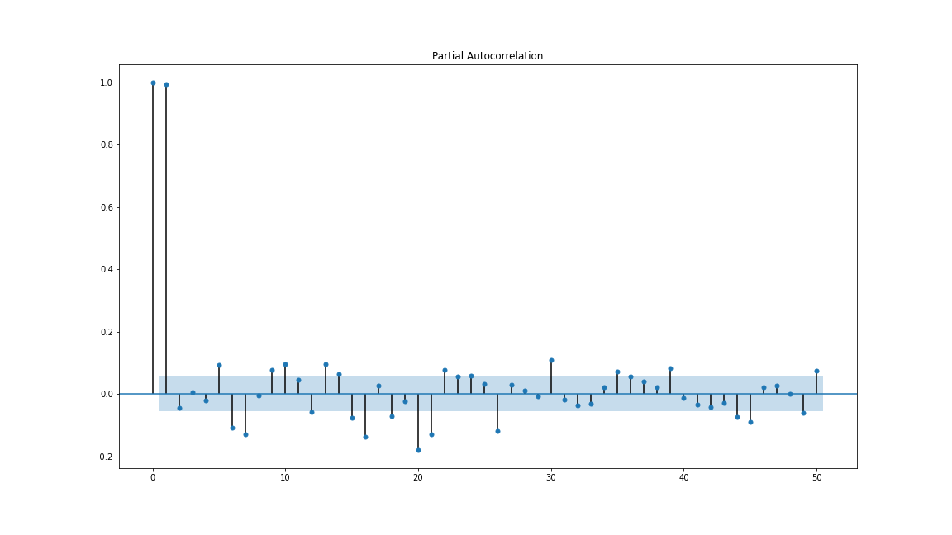
Coin Market Forecasting - Decomposition & ARIMA
Decomposition
ARIMA Model
Train-Test Split
Performance Metrics
Train MSE: 554.2
Train MAPE: 5.14
Test MSE: 288.8
Test MAPE: 3.80

Slide 7
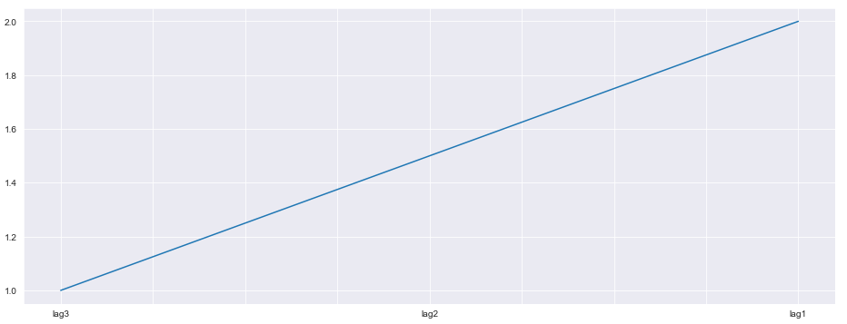
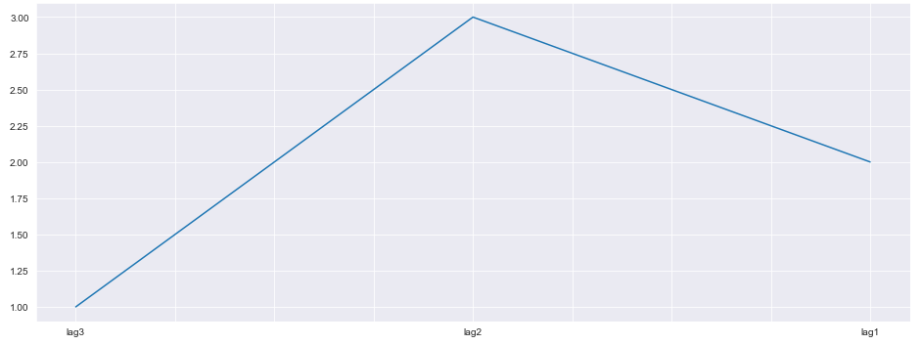
Coin Market Forecasting - Feature generation
Statistical Features
Pattern Features
An increasing trend in the last 3 days, the feature “lag3_deep” turns to 1.
Close price of Ethereum and Bitcoin, three features created in the last 5 days window Rolling Windows Statistics :
Min: minimum value observed in the last 5 days,
Mean: average of values observed in the last 5 days,
Max: maximum value observed in the last 5 days.
Close price of Ethereum and Bitcoin, three features created by using all historical data exists previous than observation day for each row called Expanding Windows Statistics:
Min: minimum value observed until the row’s date,
Mean: average of values observed until the row’s date,
Max: maximum value observed until the row’s date.
Chart: If the fluctuation in the last three days as above, “lag3_deep” feature returns 1
Lag 3 has the lowest value and lag2 has the highest value, the feature “lag3_deep_lag2_peek” turns to 1.
Datetime Features
Search Engine Features
Day of month (1-31),
Month value (1-12),
Quarter value (1-4),
Semester value (1-2),
Year,
Day of week (1-7),
Day of year (1-365),
Week of year (1-52),
Is weekend? (0-1)
Keywords imported from Google Trends for the last 5 years:
“cryptocurrency”,
“ethereum”,
“bitcoin”
Chart: If the fluctuation in the last three days as above, lag3_deep_lag2_peek” feature returns 1

Slide 8
XGBoost Pipeline
Coin Market Forecasting - XGBoost-Pipeline
XGBoost Pipeline
Pre-Processing
Feature Selection
Model
Categorical Features
XGBoost is applied related to problem type. For given hyperparameters, feature importance weights are ranked, and features are selected based on threshold hyperparameter which is provided to the pipeline.
XGBoost is applied related problem type with selected features in feature selection step. With RandomizedSearchCV, hundreds of iterations are done with 10 folds cross validation. Here, not shuffling rows is crucial because keeping consecutive dates in the same fold brings advantage of time-series and avoids from bias.
One Hot Encoding
Circle Features
Circle Encoding
Numerical Features
Min Max Scaler

Slide 9
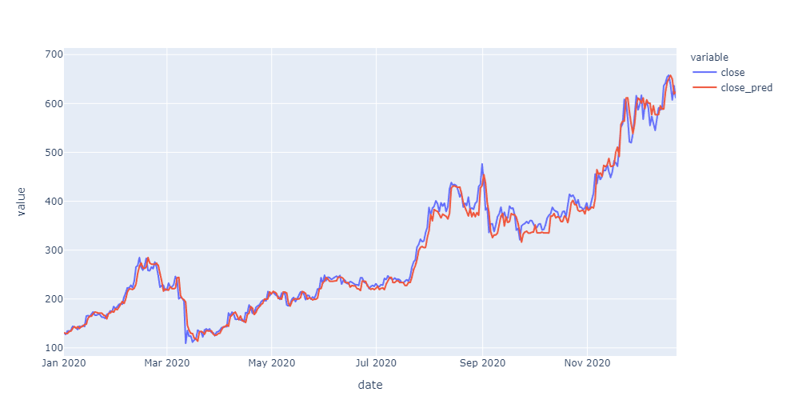
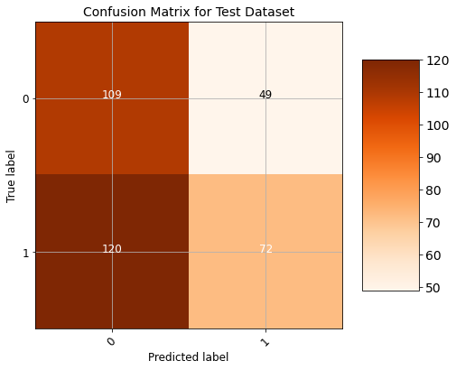
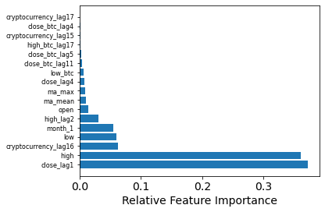
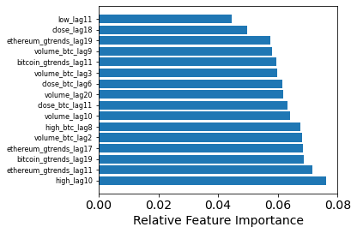
Coin Market Forecasting - XGBoost-Results
XGBoost-Regression
XGBoost-Classification
Chart: Close price and prediction in out-of-time datasets (After January 2020)
Chart: Confusion matrix for training and test datasets respectively
Chart: Relative feature importance of regression
Chart: Relative feature importance of classification

Slide 10
Coin Market Forecasting - Trading Algorithm
- Trading decisions play an important role to make profit in the market.
- Optimized and well-designed trading algorithm turns a good model to successful buy and sell actions.
- The algorithm decides to buy and sell points for user according to predictions from the model.
- It runs daily basis and returns “BUY”, “SELL” or “DO NOTHING”.
Trading Algorithm Pseudo Code
Inputs:
buy_multiplier: multiplier for the moment of buy decision
sell_multiplier: multiplier for the moment of sell decision
commission_rate: commission rate applied in the market
amount: number of Ethereum in the account, 0 at the start
budget: budget in the account, >0 at the start
BEGIN with first row of data
IF amount = 0 and today’s prediction > yesterday’s price * buy_multiplier*(1+ commission_rate):
Give “BUY” order
amount = budget / (yesterday’s price*(1+ commission_rate))
buy_price = yesterday’s price*(1+ commission_rate)
ELIF amount> 0 and buy_price > prediction* (sell_multiplier^2):
Give “SELL” order
budget = amount* yesterday’s price * (1-comission_rate)
sell_price = yesterday’s price * (1-comission_rate)
amount = 0
ELIF amount> 0 and yesterday’s price* (1-comission_rate) > prediction* sell_multiplier:
Give “SELL” order
budget = amount* yesterday’s price * (1-comission_rate)
sell_price = yesterday’s price * (1-comission_rate)
amount = 0
REPEAT for next row until the last row
END
Optimization
Buy and sell multiplier are optimized in training dataset,
They can be applied through test dataset.
The optimized values can be found with a grid search on multiplier parameters.
For both buy and sell multipliers a reasonable range is defined, and each combination is tried to reach highest budget level at the end of the date range for training dataset and applied to test dataset.
There is commission rate parameter in some cases. In real world usual commission rate for each transaction is 0.25%. It effects optimized multipliers.
For this reason, both with commission and without commission cases are drawn and will be explained under Evaluation topic.

Slide 11
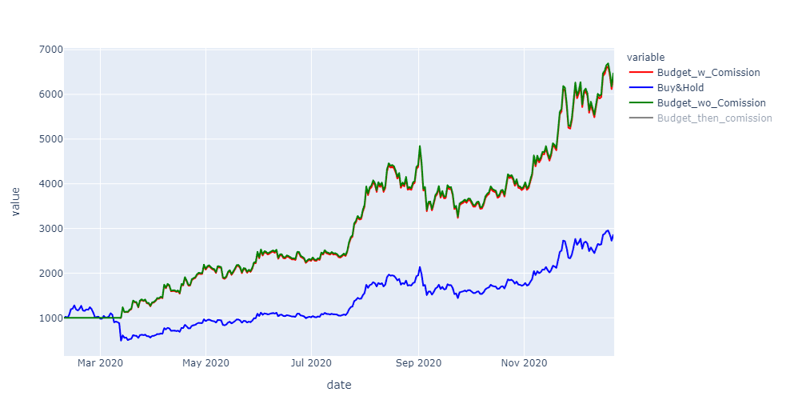
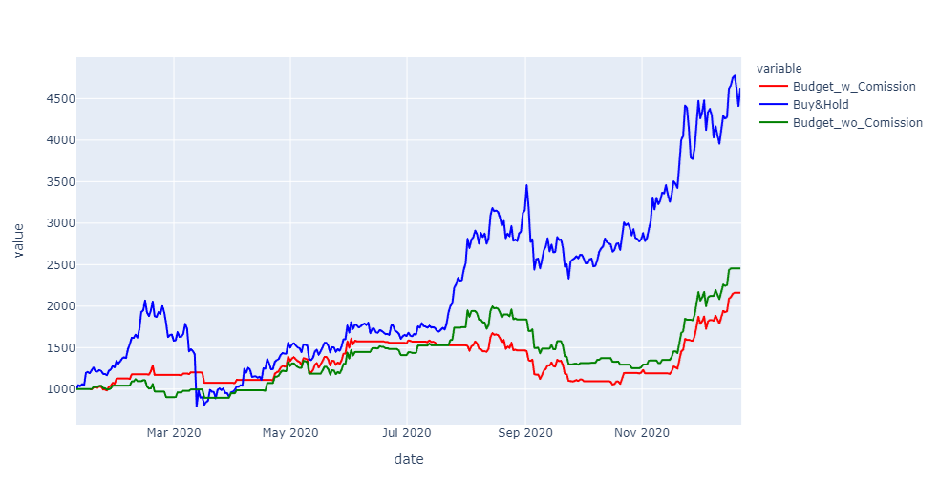
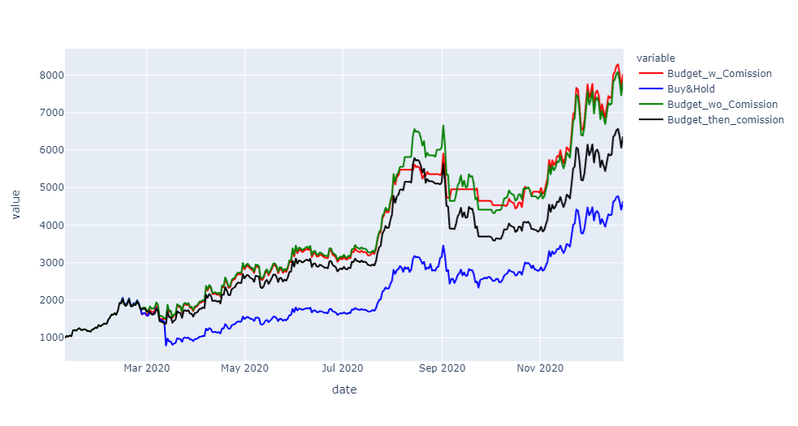
Coin Market Forecasting – Evaluation - Individual Models
ARIMA
XGBoost Classification
XGBoost Regression

Slide 12
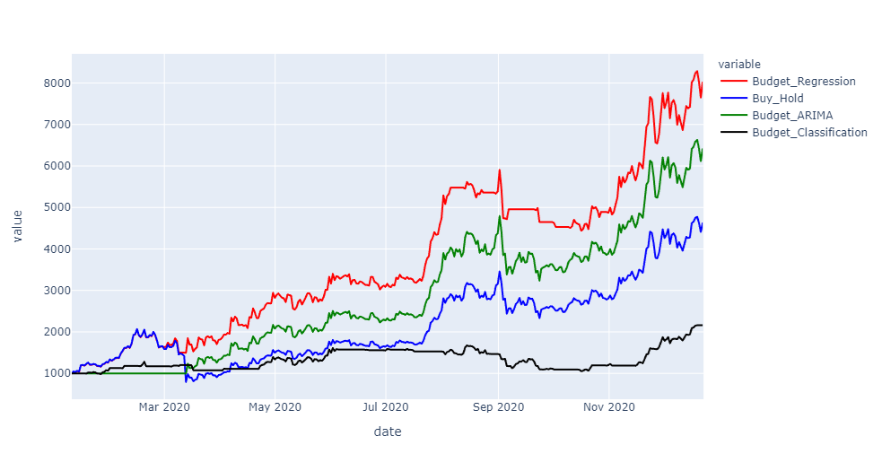
Coin Market Forecasting - Evaluation
- XGBoost regression overperforms other strategies. The chart at below shows the strategies with 0.25% commission rate.
- While Buy&Hold strategy would bring around $4000 with $1000 starting budget, XGBoost regressor reached around $8000 after commissions deducted.

Slide 13



Coin Market Forecasting - Further Research & Discussion
Further Research
Discussions
Market Manipulation
Does it possible to beat the market?
- The answer is yes.
Social Media & News
Coin Whales
Does it possible to consistently beat the market?
- The main issue is keeping it sustainable
The Bitcoin Whales: 1,000 People Who Own 40 Percent of the Market
Let’s say an investor beats the market, at what cost?
- Risk & Reward
- Health
Survivorship Bias
- The number of failed attempts is compared to successful ones, may be explained with randomness.
Short Positions
Leverage
Different Coins

